Slide 1
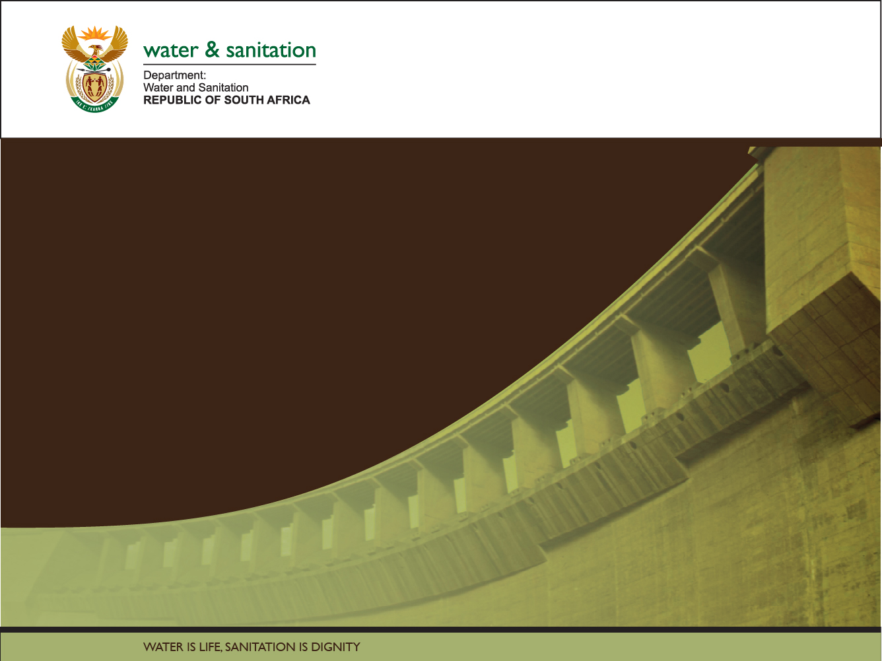

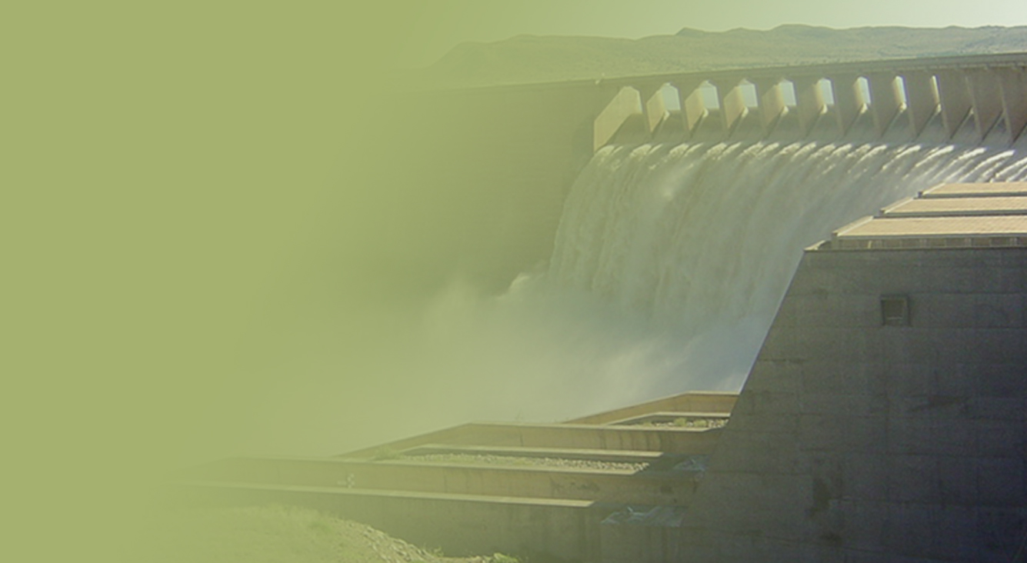
The Determination of Water Resources Classes and Resource Quality Objectives for the water resources in in the Breede-Gouritz WMA
Focus on Gouritz-Coastal area
Technical Task Group meeting 2: Presentation and workshopping of draft Resource Quality Objectives
Overview of the RQOs Process
Presented by: Erik van der Berg
12-16 March 2018
Carmel Guest Farm, Victoria Bay

Slide 2
Study Objectives
Co-ordinate implementation of the Water Resources Classification System (WRCS):
  Determine Water Resources Classes (WRCs)
  Determine Resource Quality Objectives (RQOs)
  Support Gazetting of Recommended Water Resources Classes and RQOs
  for the water resources in the Breede-Gouritz WMA:
  - Rivers - Estuaries - Groundwater
  - Dams - Wetlands

Slide 3
Objectives of the TTG Meeting
Provide overview of:
  Study progress to date
  Approach followed to determine RQOs
Present and workshop RQO findings:
  Prioritisation of Resource Units (RUs)
  Evaluation of Resource Units (prioritised RUs)
  RQOs for Resource Units (prioritised RUs)

Slide 4
TTG Meeting arrangements
Mon 12 – Wed 14 March: Breede-Overberg
  Robertson
Thu 15 – Fri 16 March: Gouritz Coastal
  George
Separate work sessions for resource types:
  Surface water, estuaries, dams, wetlands & groundwater
Different agenda each day

Slide 5
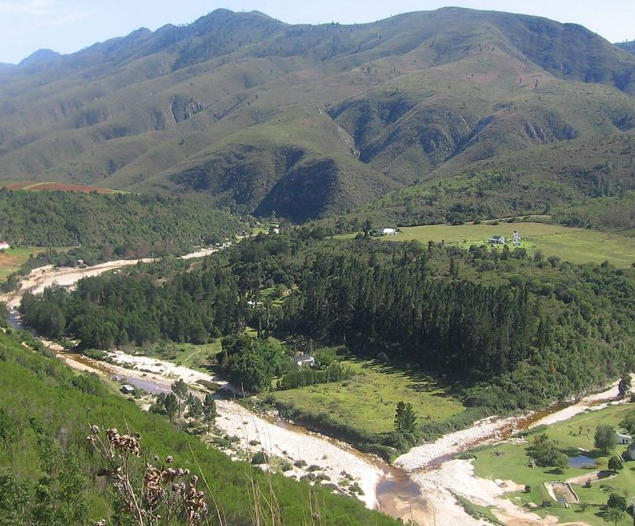

Overview of Study Progress

Slide 6
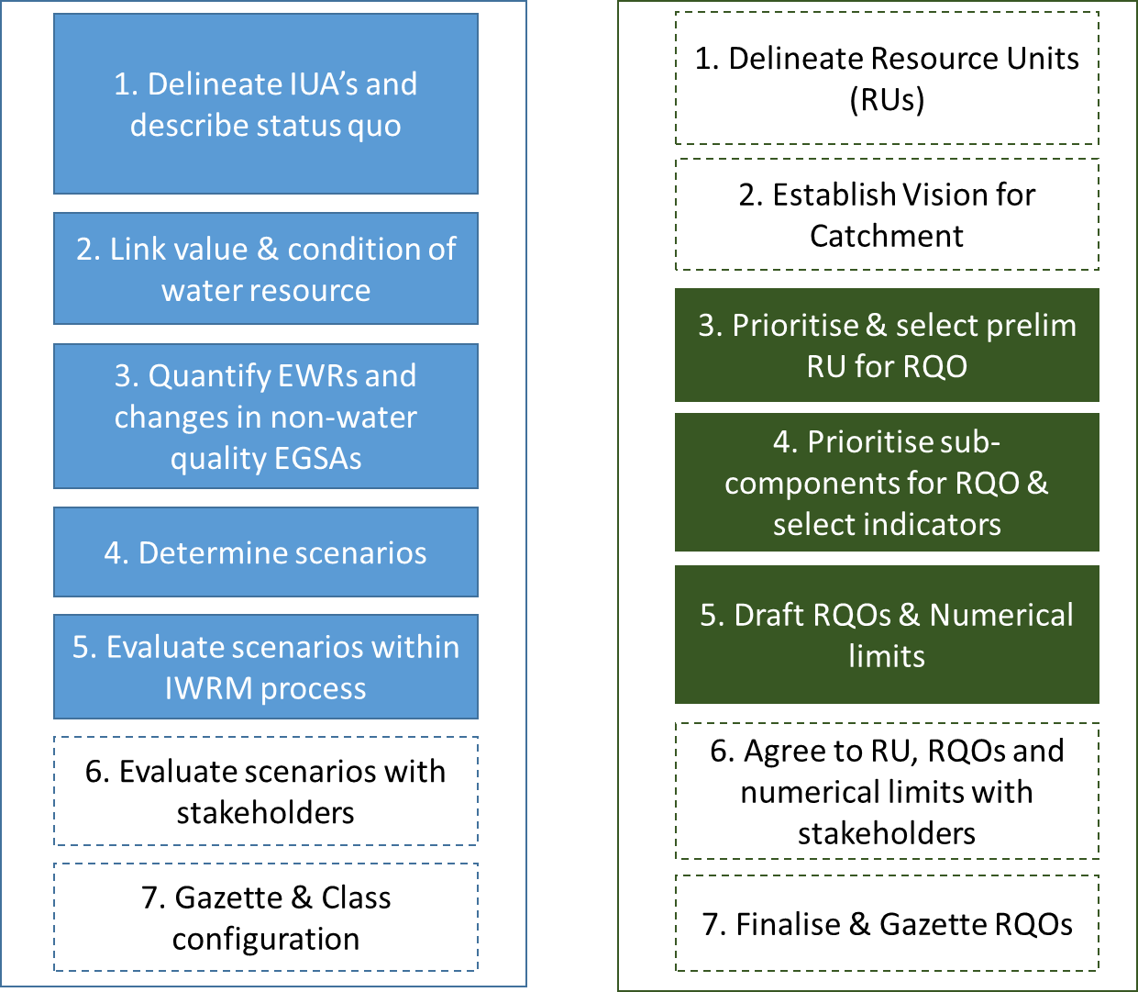

Classification and RQOs Steps
7-step process to determine WRCs
7-step process to determine RQOs
Aligned
Gazette WRC & RQO

Slide 7
Defined Integrated Units of Analysis (IUAs)
  Identified significant resources:
    Based on Physical, Biological & Socio-economic factors
  Each IUA represents a similar area requiring a Water Resources Class (WRC)
  Why do we need these?
    Broad-scale units to assess socio-economic implications of scenarios (possible future situations)
    Report on ecological conditions at a sub-catchment scale
    Set WR Classes for different parts of a catchment
  18 IUAs delineated - 10 in the Breede-Overberg & 8 in the Gouritz-Coastal areas

Slide 8
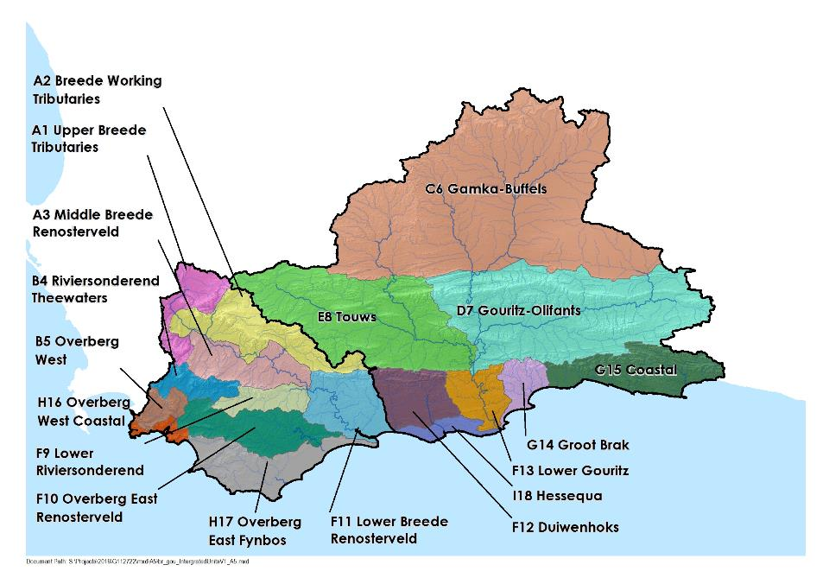
18 Integrated Units of Analysis

Slide 9
Defined Resource Units (RUs) and Nodes
Resource units (RUs) are grouped areas e.g. river basins, deemed similar in terms of various characteristics
Are used to transfer information between catchments
Groundwater
  Nodes are locations of interest (points) in a water resource (rivers, dams, wetlands, estuaries)
  Are sited using:
  Water infrastructure
  Aquatic ecosystem attributes
  Are used to allocate water for environment and development

Slide 10
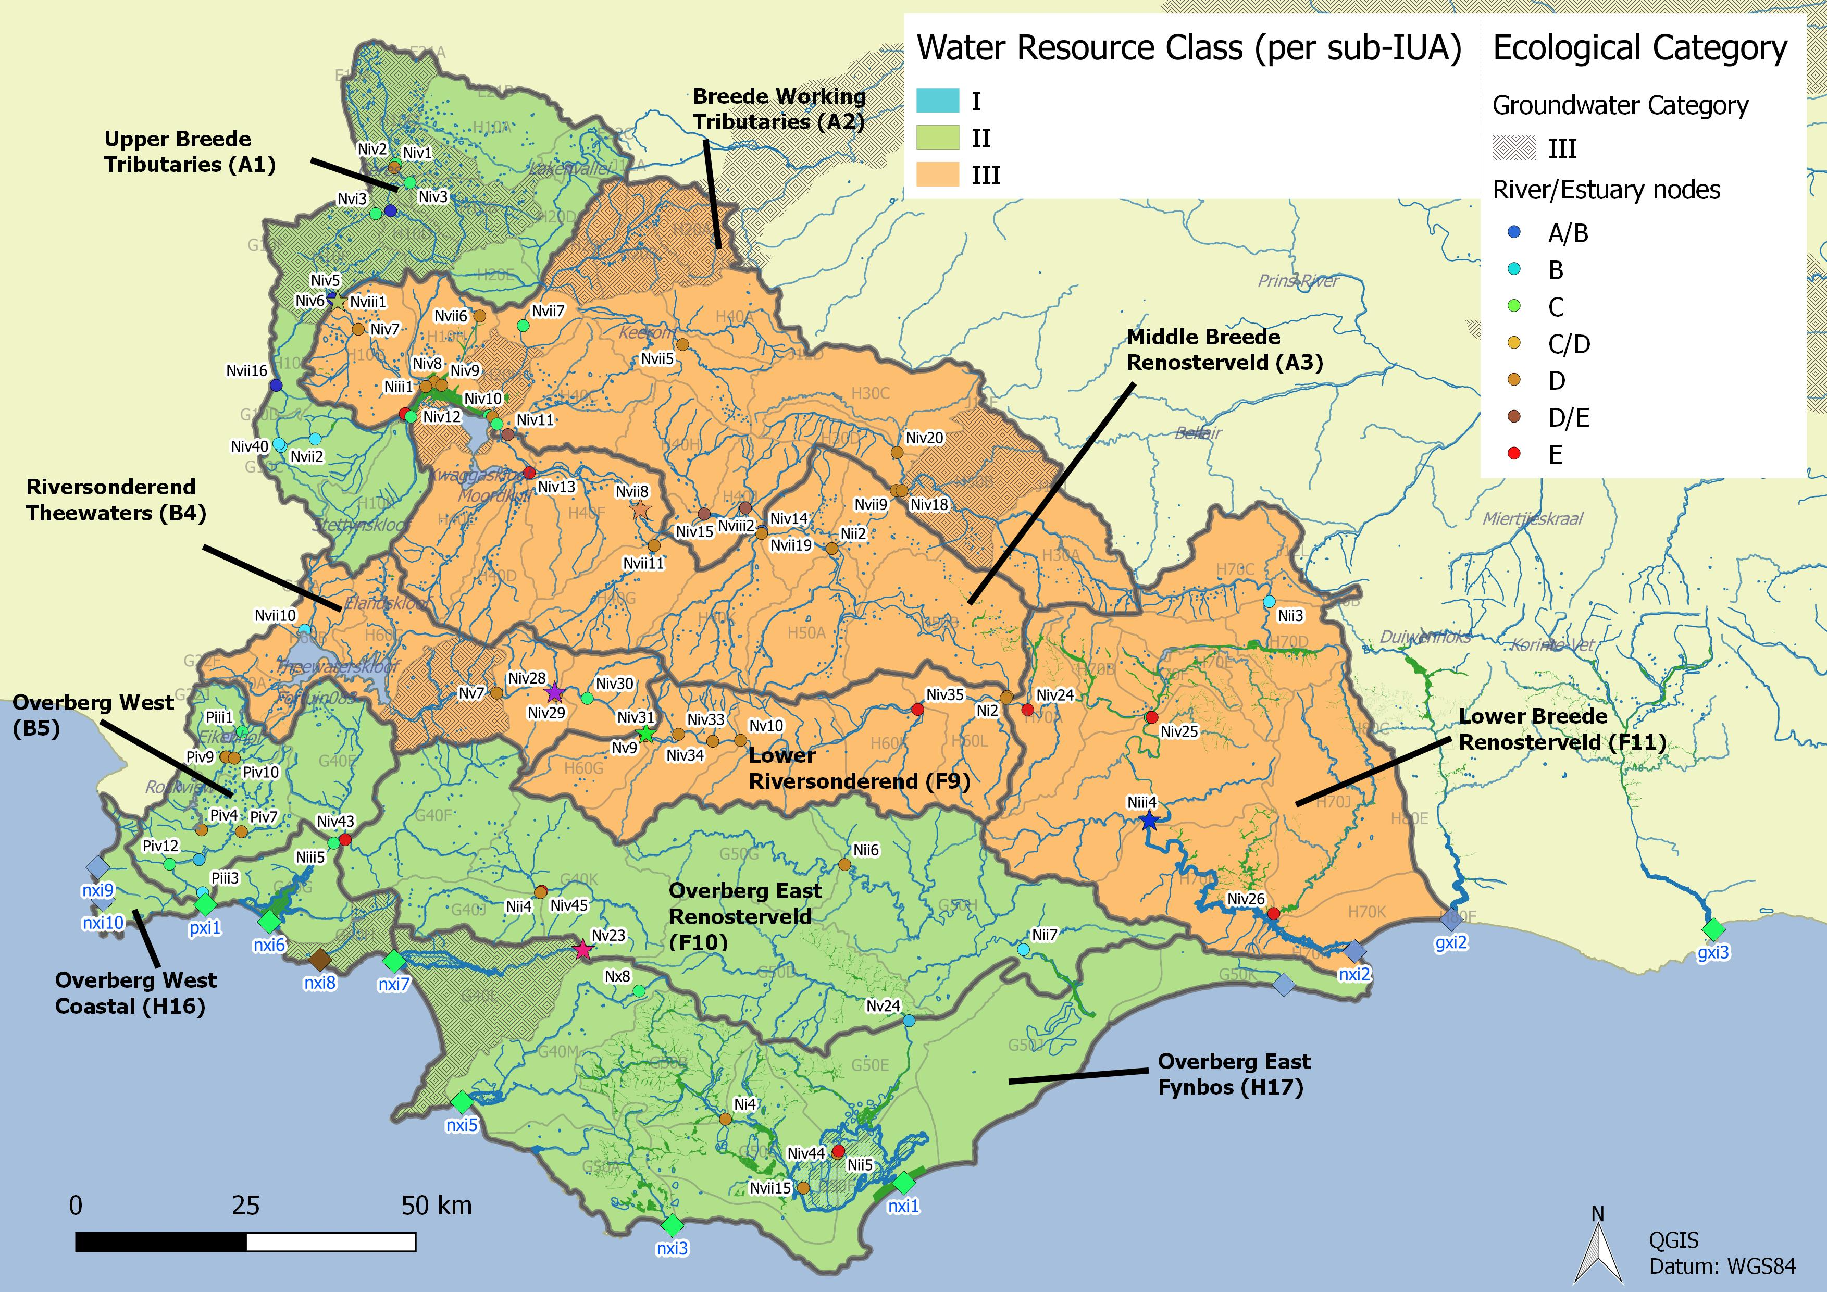
Integrated Units of Analysis and Nodes
Breede-Overberg Region

Slide 11
Breede-Overberg Region
 | Integrated Unit of Analysis (IUA) | Recommended Classes
 | A1 Upper Breede Tributaries | II
 | A2 Middle Breede Renosterveld | III
 | A3 Breede Working Tributaries | III
 | B4 Riversonderend Theewaters | III
 | F9 Lower Riversonderend | III
 | B5 Overberg West | II
 | H16 Overberg West Coastal | II
 | F10 Overberg East Renosterveld | II
 | H17 Overberg East Fynbos | III
 | F11 Lower Breede Renosterveld | II

Slide 12
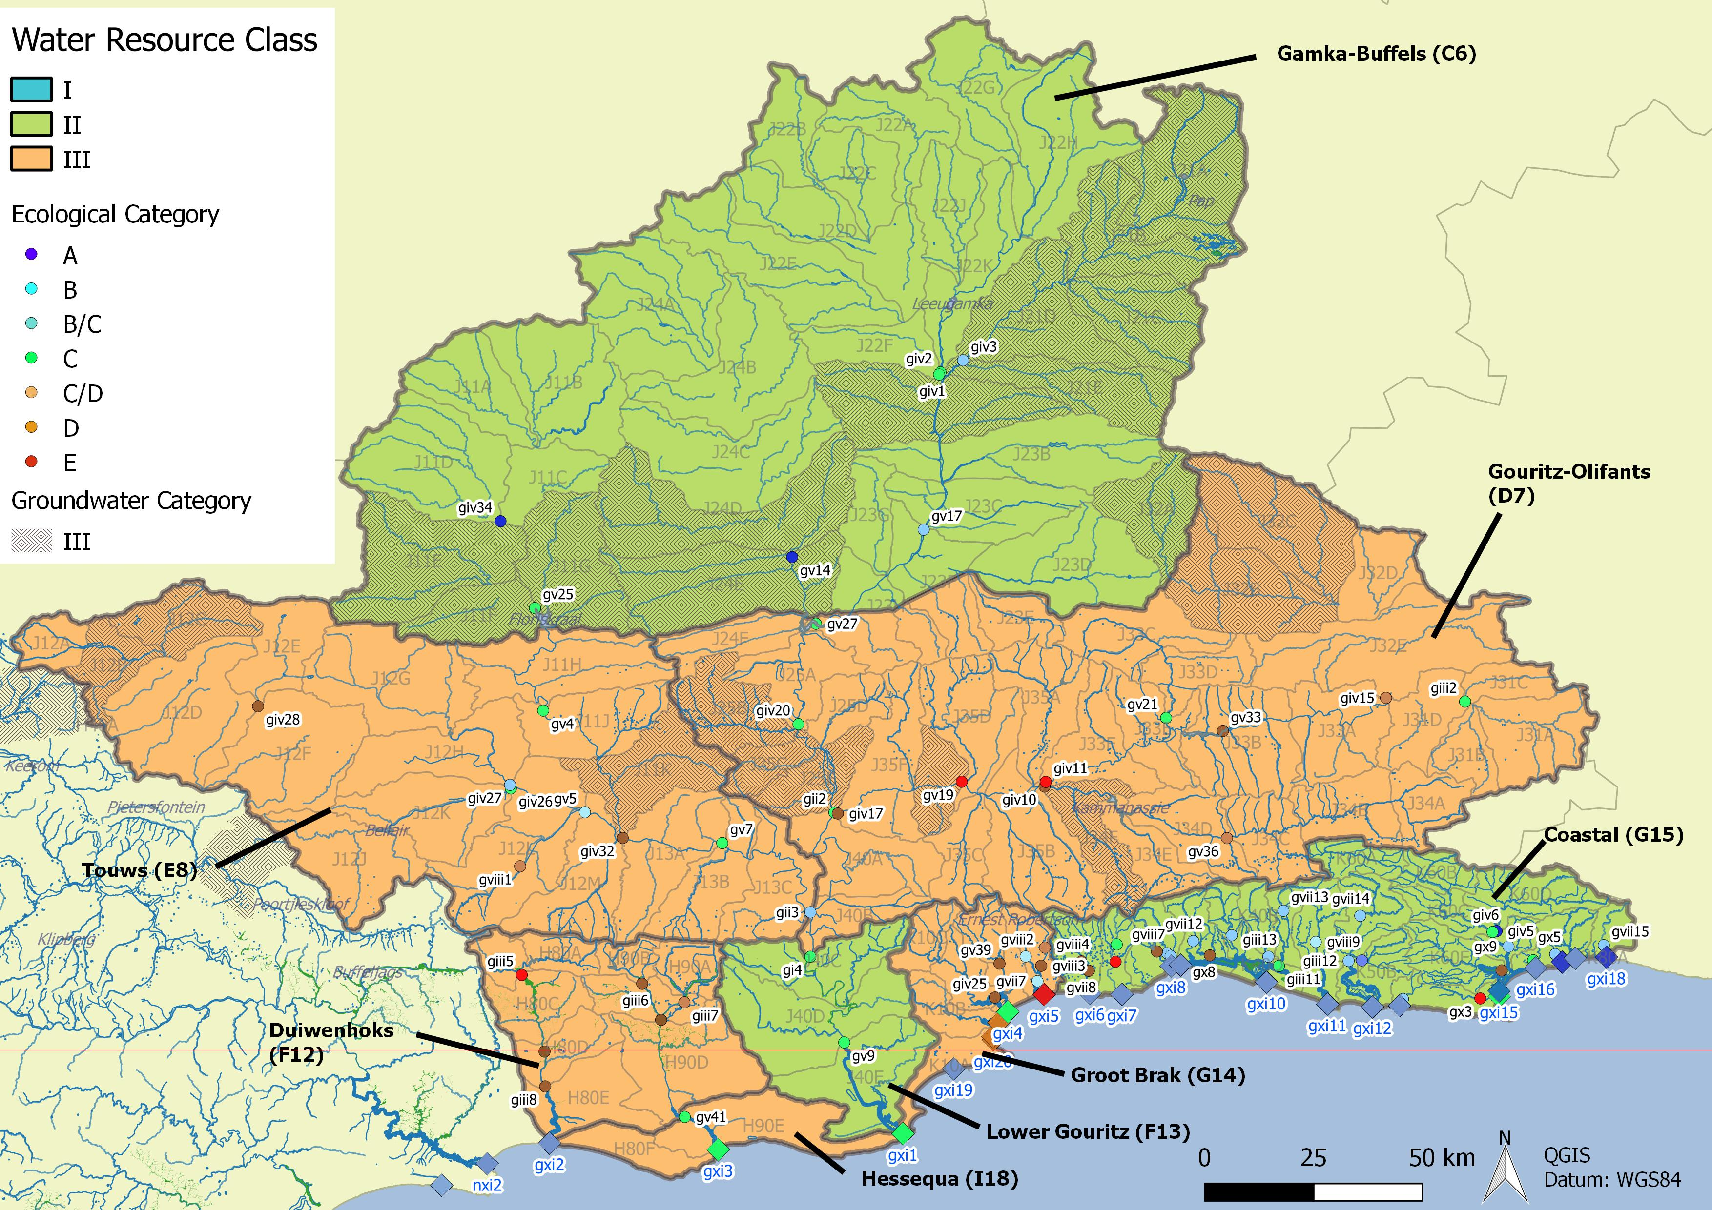
Integrated Units of Analysis and Nodes
Gouritz-Coastal Region

Slide 13
Gouritz-Coastal Region
 | Integrated Unit of Analysis (IUA) |  | Recommended Classes
 | Gamka Buffels | C6 | II
 | Touws | E8 | III
 | Gouritz-Olifants | D7 | III
 | Lower Gouritz | F13 | II
 | Duiwenhoks | F12 | III
 | Hessequa | I18 | III
 | Groot Brak | G14 | III
 | Coastal | G15 | II

Slide 14
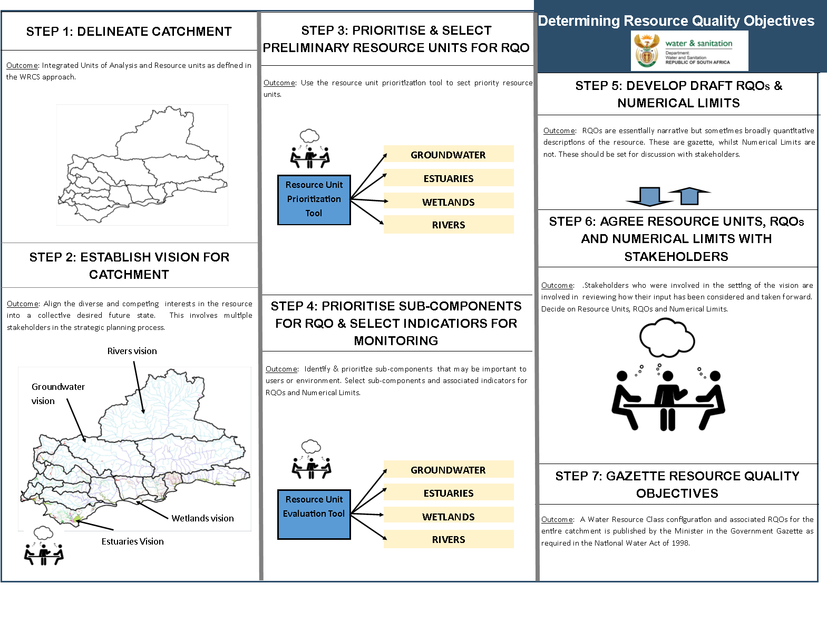
Study Status: RQOs
DAMS
Draft
Complete
Draft
Complete
DAMS
Draft
Notes:
Erik to present progress, Reminder of two stage process (Classification followed be RQOs – but gazetted together). Link to RQOs? Then zoom in on the classification process

Slide 15
Comments on draft RQO Reports
Three RQO Reports disseminated for comment:
  Resource Unit Prioritisation Report
  Evaluation Resource Units Report
  Outline of RQOs Report
Please provide comment by 22 March to:
  Esther Lekalake (LekalakeE@dws.gov.za), or
  Louise Lodenkemper (Louise.Lodenkemper@aurecongroup.com)

Slide 16
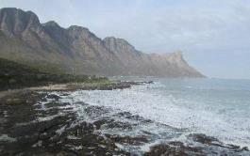
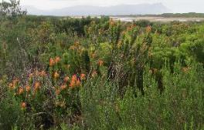
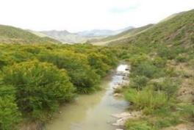
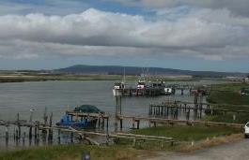
Thank you, Any discussion?

Slide 17

The Determination of Water Resources Classes and Resource Quality Objectives for the water resources in in the Breede-Gouritz WMA
Focus on Gouritz-Coastal area
Technical Task Group meeting 2: Presentation and workshopping of draft Resource Quality Objectives
RQOs for DAMS – Gouritz-Coastal area
Presented by: Erik van der Berg
15 March 2018
Carmel Guest Farm, Victoria Bay

Slide 18
Resource Unit priorities - method
2 levels of ranking of resource units (RUs)
  First level of screening:
  Filter National List of Registered Dams (DWS Dam Safety Office) for the WMA - 717 dams
  Select dams with High or Significant Hazard potential
  Select Category 2 or 3 dams in terms of dam safety legislation
  Select (significant) dams with a capacity of more than 5 million m³
  27 dams selected in WMA
    11 dams in Gouritz-Coastal area
Notes:
Management only looks at nodes in poor condition and then EWR sites

Slide 19
Resource Unit priorities - method
  Then the DWS RU Prioritisation Tool (RUPT) steps were followed that ranks RUs against one another based on:
  position, socio-economic and international importance
  role in regulating services and ecological importance
  water quality threats
  practical considerations
Notes:
Management only looks at nodes in poor condition and then EWR sites

Slide 20
Resource Unit priorities - method
  Prioritisation Criteria evaluated in RU Prioritisation Tool:
Location in river system
Importance to users, such as recreational use, tourism, scientific benefits, aesthetic, cultural or spiritual benefits
Does it support the livelihoods of significant vulnerable communities, such as water, food or grazing and raw materials
Strategic or international obligations, for the generation of power, or for water-related agreements, such as the RAMSAR convention
Provision of supporting or regulating services, such as water supply, flood attenuation, water quality control, stream flow regulation, and sediment retention, apart from the common function of water storage
Contribution to economy
Ecological importance of RU, linked to flow releases for ecological purposes
Level of threat posed to the water quality for the environment
Practical considerations, such as the existence of EWR sites and DWS gauging weirs
Notes:
Management only looks at nodes in poor condition and then EWR sites

Slide 21
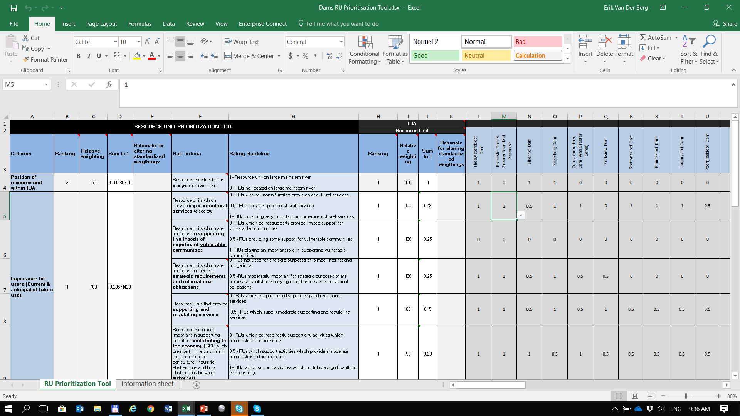
Resource Unit Prioritisation Tool

Slide 22
RUPT Priority scores for dams (RUPT) :
Gouritz-Coastal
Dams with “Priority Rating” ≥ 0.6 are prioritised
 | Stompdrift | Floriskraal | Gamkapoort | Kammanassie | Wolwedans | Leeu-Gamka | Koos Raubenheimer | Korentepoort | Garden Route | Hartbeeskuil | Duivenhoks
Position in IUA | 0.14 | 0.00 | 0.14 | 0.00 | 0.00 | 0.00 | 0.00 | 0.00 | 0.00 | 0.00 | 0.00
Concern for users | 0.16 | 0.14 | 0.04 | 0.16 | 0.20 | 0.07 | 0.11 | 0.07 | 0.11 | 0.11 | 0.07
Concern for environment | 0.00 | 0.00 | 0.00 | 0.00 | 0.36 | 0.00 | 0.00 | 0.00 | 0.07 | 0.00 | 0.00
Management and practical considerations | 0.14 | 0.14 | 0.12 | 0.14 | 0.14 | 0.09 | 0.12 | 0.09 | 0.14 | 0.14 | 0.09
Total Prioritization Score | 0.44 | 0.28 | 0.30 | 0.30 | 0.70 | 0.16 | 0.22 | 0.16 | 0.32 | 0.25 | 0.16
Relative Priority Rating | 0.6 | 0.4 | 0.4 | 0.4 | 0.9 | 0.2 | 0.3 | 0.2 | 0.4 | 0.3 | 0.2
Notes:
Evaluation Rus worked example

Slide 23
Prioritised dams
Gouritz-Coastal area
Stompdrift Dam
Wolwedans Dam
Breede-Overberg area
Theewaterskloof Dam
Greater Brandvlei Dam
Ceres-Koekedouw Dam
Kogelberg Dam
Arieskraal Dam
Notes:
Management only looks at nodes in poor condition and then EWR sites

Slide 24
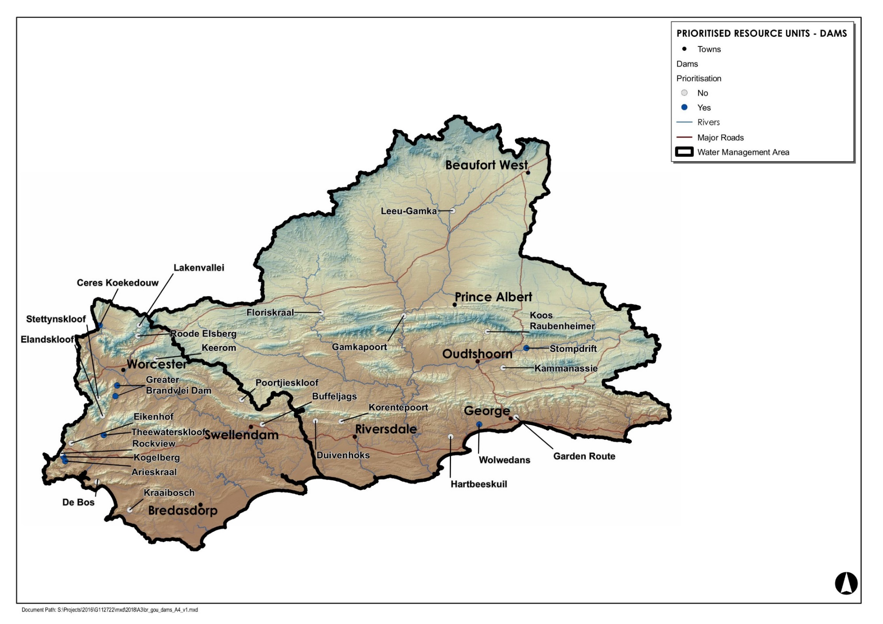
High and low priority RUs

Slide 25
Evaluation of RUs - method
Customised DWS RU Evaluation Tool used to identify selected indicators for prioritised RUs for which RQOs (descriptive and numerical) will be written, by identifying:
  Components
  Sub-components
  Indicators
Notes:
Evaluation of Rus method statement

Slide 26
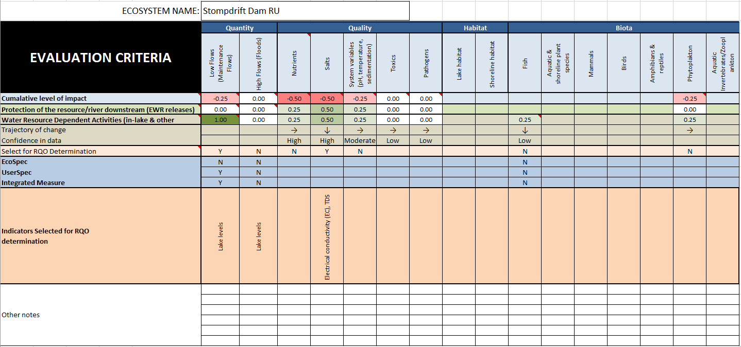
RU Evaluation Tool

Slide 27
Evaluation of RUs - method
The evaluation criteria (applied in the RU Evaluation Tool) for each of the above indicators are:
Cumulative level of impact: This is the anticipated level of impact of current and future use/activities in the upstream catchments on the inflows to the dam and the quality, habitat and biota in the dam
Protection of the Resource: Rating of importance of components for the protection of the water resource, i.e. importance to releases of water for downstream EWRs
Water Resource Dependent Activities: Rating of importance of components for protection of in-dam activities and releases of water for downstream use (irrigation, domestic/rural supply, etc.)
Components with importance scores of 0.5 and higher were selected
Notes:
Evaluation of Rus method statement

Slide 28
Evaluation of RUs - method
Examples of:
Components-sub-components-indicators
Quantity low/high/maintenance flows, dam level
EWR
Quality nutrients, salts, system variables, toxics, pathogens
Ortho-phosphate, nitrogen, ammonium, EC
Habitat riparian habitat, in-dam habitat
None selected for dams
Biota fish, phytoplankton
Index of Reservoir Habitat Impairment (IRHI) by Miranda and Hunt (2011), fish health evaluation, chlorophyll a
Notes:
Evaluation of Rus method statement

Slide 29
EXAMPLE: Stompdrift Dam
(IUA D7 Gouritz-Olifants)
There are limited economic activities upstream of the dam and the impacts on the dam are largely non-flow related. The main use of the dam is for irrigation purposes.
The Stompdrift and Kammanassie dams are the main sources of water for irrigation in the Klein Karoo, providing water to farms through a system of canals extending more than 75 km along the Olifants River valley downstream of the dams (Stompdrift-Kammanassie WUA).
The water from the two dams and from other sources has been significantly over-allocated. As a result, water can only be supplied erratically, and in some years only at a fraction of the full allocation, making irrigated agriculture very difficult to manage and sustain.
There is no EWR site in the Olifants River downstream.
The river deteriorates significantly below the dam, relating to the minimal flow in the river, extensive reed growth in the channel, irrigation return flows and irrigation fields in the riparian zone. Recreational activities include kayaking, cruises, angling, swimming, etc.

Slide 30
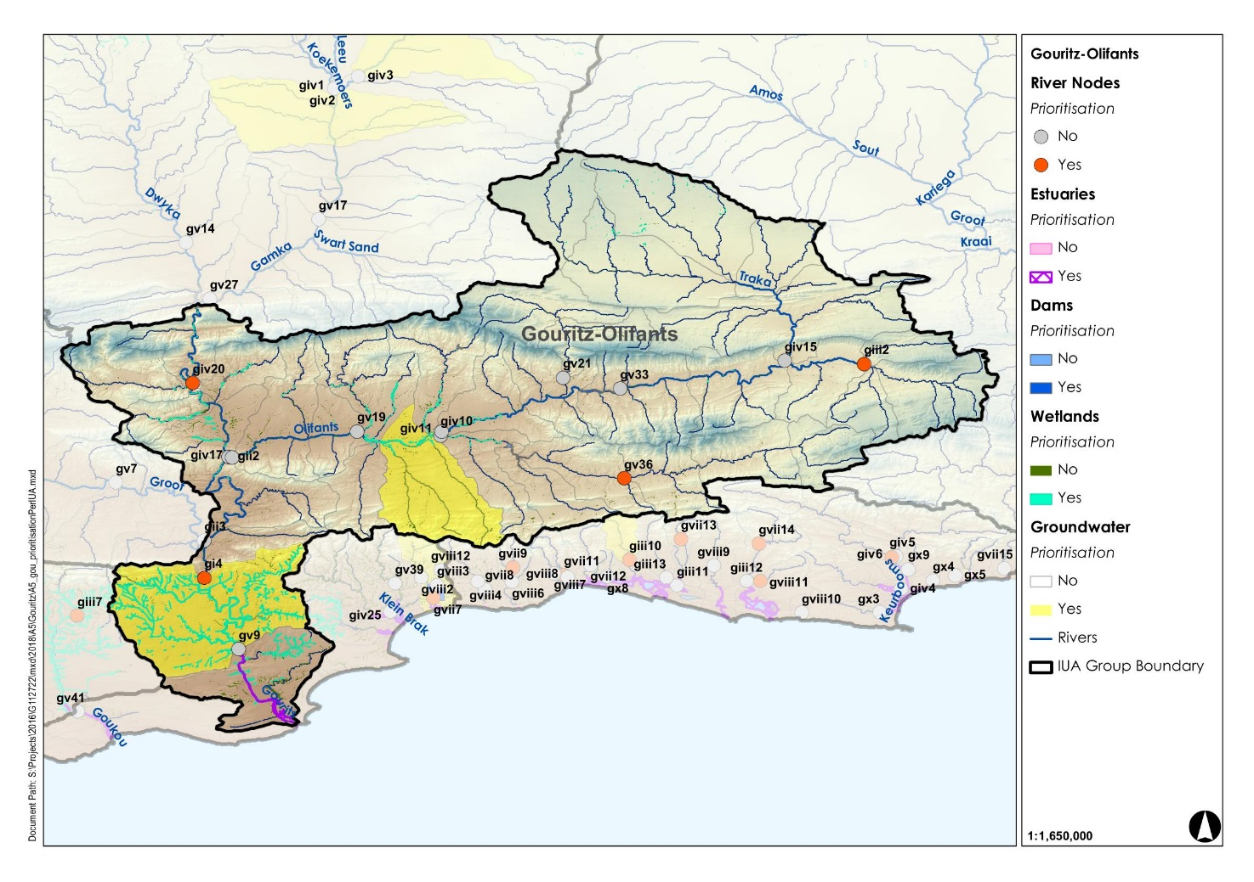
Stompdrift Dam (IUA D7 Gouritz-Olifants)

Slide 31
Stompdrift Dam
(IUA D7 Gouritz-Olifants)
Sub-comp. | Rationale for sub-component choice | Indicator selection
Low flows (QUANTITY) | Dam levels must remain sufficient to provide for industrial use | Dam levels
Salts (QUALITY) | Salt levels must be maintained at concentrations where they do not impact negatively on the ecosystem | Electrical conductivity

Slide 32
Outline of RQOs - method
Targeted Ecological Category (TEC) = Spatially Targeted Scenario, where info is available
2 high priority RUs in the Gouritz-Coastal area
  Evaluate present status and suitability of data
For the selected sub-components and indicators of each dam:
  Write descriptive RQOs (narratives)
  Set numerical limits
  Set Thresholds of Potential Concern (TPCs)
Notes:
RQOs method statement

Slide 33
Quantity & Quality RQOs for Stompdrift Dam
Sub-comp. | Narrative description | Indicator/ measure | Numerical limits | TPC | Present state (50/95%tile) J3R002Q01
Low flows | During the dry season dam levels must be sufficient for releases for irrigation and human use and protection of ecosystem function down/stream. | No EWR site | No EWR site | Not applicable | Not applicable
Salts | Salt levels must be maintained at concentrations where they do not impact negatively on the ecosystem and are in an Acceptable category for municipal treatment and rural use. | Electrical conductivity | 95th percentile ≤ 150 mS/m - | 140 mS/m | 85.8 / 149

Slide 34
Wolwedans Dam
(IUA G15 Coastal)
There are dryland and irrigated agriculture upstream of the dam, as well as some small farms dams, which impedes low flow.
The dam is the main source of water for the municipality of Mossel Bay (Mossel Bay, Kleinbrak, Grootbrak) as well as the gas-to-liquids refinery PetroSA, i.e. municipal and industrial water supply.
The dam has a significant impact on the downstream flow regime, and releases to the Groot Brak estuary is essential to meet the estuarine EWR requirements and to ensure estuarine health.

Slide 35
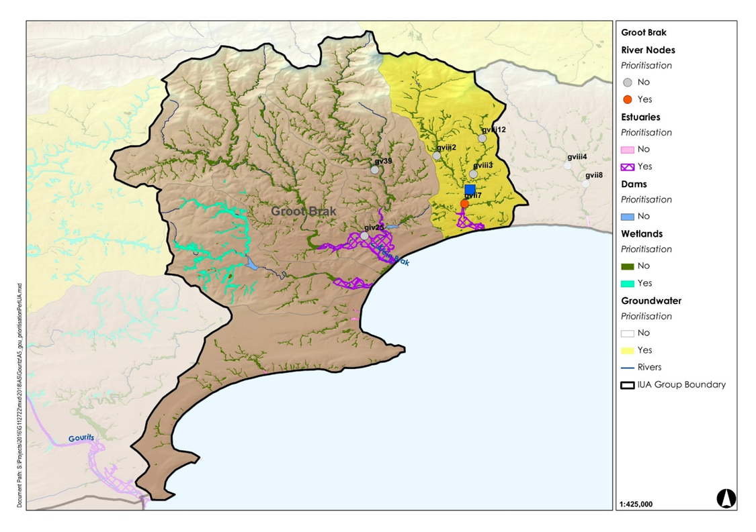
Wolwedans Dam (IUA G15 Coastal)

Slide 36
Wolwedans Dam
(IUA G15 Coastal)
Sub-comp. | Rationale for sub-component choice | Indicator selection
Low flows (QUANTITY) | Dam levels must remain sufficient to provide for municipal and industrial use, as well as releases for ecosystem function of the downstream estuary. | EWR
High flows (QUANTITY) | During the wet season the dam levels must be maintained such that they are able to support releases for estuarine ecosystem function. | EWR
Nutrients (QUALITY) | The system must be maintained in a mesotrophic state. | Ortho-phosphate, nitrogen, ammonium
Salts (QUALITY) | Salt levels must be maintained at concentrations where they do not impact negatively on the ecosystem and are acceptable for industrial use by PetroSA and for municipal treatment. | Electrical conductivity
Realistic to try and meet high-flow EWR?

Slide 37
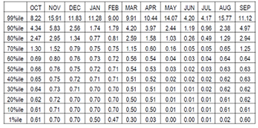
Quantity RQOs for Wolwedans Dam
Sub-comp. | Narrative description | Indicator/ measure | Numerical limits | TPC
Low flows | During the dry season dam levels must be sufficient for releases for industrial and urban use and protection of ecosystem function downstream. | Flow releases: Groot Brak Estuary EWR in K20A nMAR = 27.0 million m3/a pMAR: 0.92 million m3/a REC = C category | Ecological flow distribution in the Groot Brak estuary: | Not applicable
High flows | During the wet season dam levels must be maintained such that they support ecosystem function and human use.

Slide 38
Quantity Numerical Limits for Wolwedans Dam

Slide 39
Quality RQOs for Wolwedans Dam
Sub-comp. | RQO Narrative description | Indicator | Numerical Limits | Threshold of Potential Concern | Present state (50/95%tile) K2R002Q01
Nutrients | The system must be maintained in a mesotrophic state or better. | Ortho-phosphate (PO₄-P) | Median ≤ 0.025 mg/ ℓ P | 0.020 mg/ ℓ P | 0.033 / 0.067
 |  | Total inorganic nitrogen (TIN) | Median ≤ 1.00 mg/ℓ N | 0.80 mg/ℓ N | 0.108 /0.319
Salts | Salt levels must be maintained at concentrations where they do not impact negatively on the ecosystem and are acceptable for industrial and urban use. | Electrical conductivity | 95th percentile ≤ 85 mS/m | ≤ 75 mS/m | 25.1 / 61.8

Slide 40
Thank you!

Slide 41
ADDITIONAL SLIDES

Slide 42
Methodology for Determination of RQOs
Notes:
Erik and team to present the methodology used for scenario evaluation

Slide 43
Integrated Units of Analysis
Socio-economic Zone | Zone Code | River Resource Unit | IUA Name | IUA Code
Upper and Middle Breede | A | Upper Breede Tributaries | Upper Breede Tributaries | A1
 |  | Breede Working | Breede Working Tributaries | A2
 |  | Middle Breede Renosterveld | Middle Breede Renosterveld | A3
Upper Riversonderend and Palmiet | B | Riviersonderend Upper | Riviersonderend Theewaters | B4
 |  | Overberg West (part 1 of 3) | Overberg West | B5
Great Karoo | C | Groot/Touws (part 1 of 2) | Gamka-Buffels | C6
 |  | Gamka (part 1 of 2)
Little Karoo West | D | Lower Gouritz (part 1 of 2) | Gouritz-Olifants | D7
 |  | Olifants
Little Karoo East | E | Groot/Touws (part 2 of 2) | Touws | E8
Wheat belt | F | Riviersonderend Lower | Lower Riviersonderend | F9
 |  | Overberg West (part 2 of 3) | Overberg East Renosterveld | F10
 |  | Overberg East Renosterveld (part 1 of 2)
 |  | Lower Breede Renosterveld | Lower Breede Renosterveld | F11
 |  | Duiwenhoks (1 of 2) | Duiwenhoks | F12
Garden Route coast | G | Coastal Rivers (1 of 2) | Groot Brak | G14
 |  | Coastal Rivers (2 of 2) | Coastal | G15
Overberg coast | H | Overberg West (3 of 3) | Overberg West Coastal | H16
 |  | Overberg East (Fynbos) | Overberg East Fynbos | H17
Hessequa coast | I | Duiwenhoks (2 of 2) | Hessequa | I18

Slide 44
Integrated Units of Analysis and Nodes
Breede-Overberg Region

Slide 45
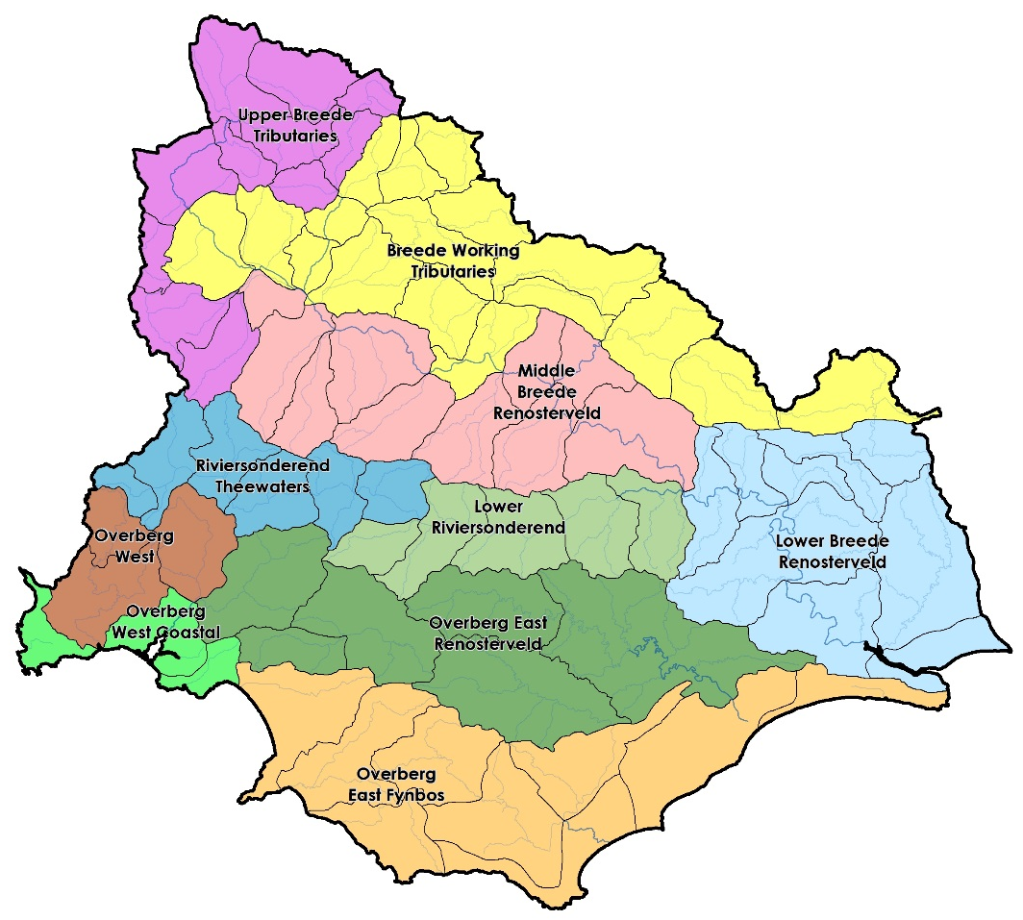
Integrated Units of Analysis
Breede-Overberg area
Delineated by a combination of socio-economic and biotic boundaries
Notes:
Part of the purpose is to try focus attention at all the areas of the basin that differ from one another…to be representative as a whole across the basin

Slide 46
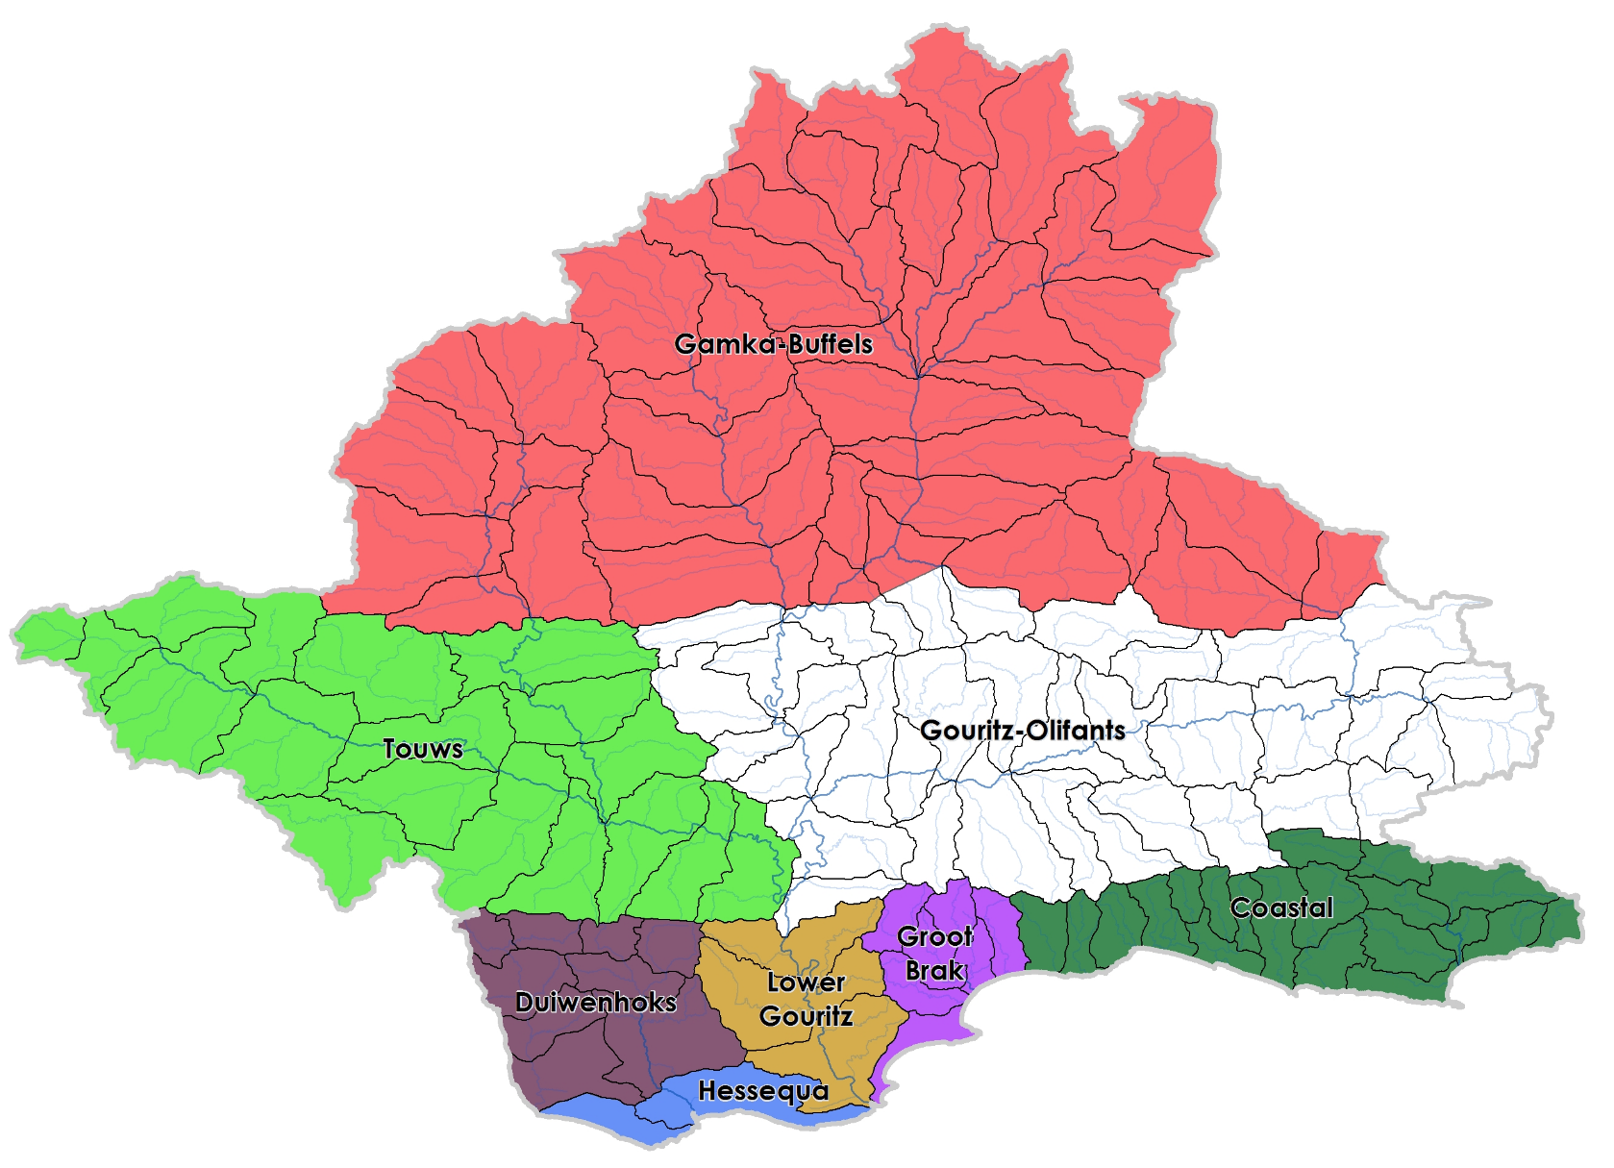
Integrated Units of Analysis
Gouritz-Coastal area
Delineated by a combination of socio-economic and biotic boundaries
Notes:
Part of the purpose is to try focus attention at all the areas of the basin that differ from one another…to be representative as a whole across the basin

Slide 47
Integrated Units of Analysis and Nodes
Gouritz-Coastal Region

Slide 48
Prioritisation Criteria evaluated in RU Prioritisation Tool
Location in river system
Importance to users
Level of support of livelihoods of vulnerable communities,
Strategic or international obligations
Provision of supporting or regulating services
Contribution to the economy
Ecological importance of RU i.t.o. flow releases
Level of threat posed to water quality
Practical considerations
Notes:
Management only looks at nodes in poor condition and then EWR sites

Slide 49
RUPT Priority scores for dams:
Breede-Overberg
Dams with “Priority Rating” ≥ 0.6 are prioritised
 | Theewaterskloof | Greater Brandvlei | Eikenhof | Kogelberg | Ceres Koekedouw | Rockview | Stettynskloof | Elandskloof | Lakenvallei | Poortjieskloof | Keerom | Roode Elsberg | De Bos | Arieskraal | Kraaibosch | Buffeljags
Position in IUA | 0.14 | 0.00 | 0.14 | 0.14 | 0.00 | 0.00 | 0.00 | 0.00 | 0.00 | 0.00 | 0.00 | 0.00 | 0.00 | 0.14 | 0.00 | 0.00
Concern for users | 0.21 | 0.21 | 0.14 | 0.18 | 0.16 | 0.11 | 0.09 | 0.09 | 0.09 | 0.07 | 0.07 | 0.05 | 0.05 | 0.05 | 0.05 | 0.07
Concern for environment | 0.29 | 0.29 | 0.00 | 0.29 | 0.14 | 0.00 | 0.00 | 0.00 | 0.00 | 0.00 | 0.00 | 0.00 | 0.00 | 0.29 | 0.00 | 0.00
Management and practical considerations | 0.14 | 0.14 | 0.14 | 0.14 | 0.14 | 0.09 | 0.09 | 0.14 | 0.14 | 0.14 | 0.14 | 0.14 | 0.09 | 0.12 | 0.09 | 0.14
Total Prioritization Score | 0.79 | 0.64 | 0.43 | 0.75 | 0.44 | 0.20 | 0.18 | 0.23 | 0.23 | 0.21 | 0.21 | 0.20 | 0.14 | 0.60 | 0.14 | 0.21
Relative Priority Rating | 1.0 | 0.8 | 0.5 | 1.0 | 0.6 | 0.3 | 0.2 | 0.3 | 0.3 | 0.3 | 0.3 | 0.3 | 0.2 | 0.8 | 0.2 | 0.3
Notes:
Evaluation Rus worked example

